Slide 1
Sales Dataset Analysis - Advanced Excel Project
Mohammed Abdul Rahman, 20 April 2025, Data Analytics & Data Science, March Evening Batch

Slide 2
Project Overview & Objectives
Project Overview: To analyze sales data to identify trends, understand sales performance, and provide actionable business insights.
Project Objectives: key goals of the analysis, such as:
Analyze sales trends over time.
Identify high-performing products and sales channels.
Determine the impact of returns and discounts.
Create a dynamic dashboard with key metrics.

Slide 3
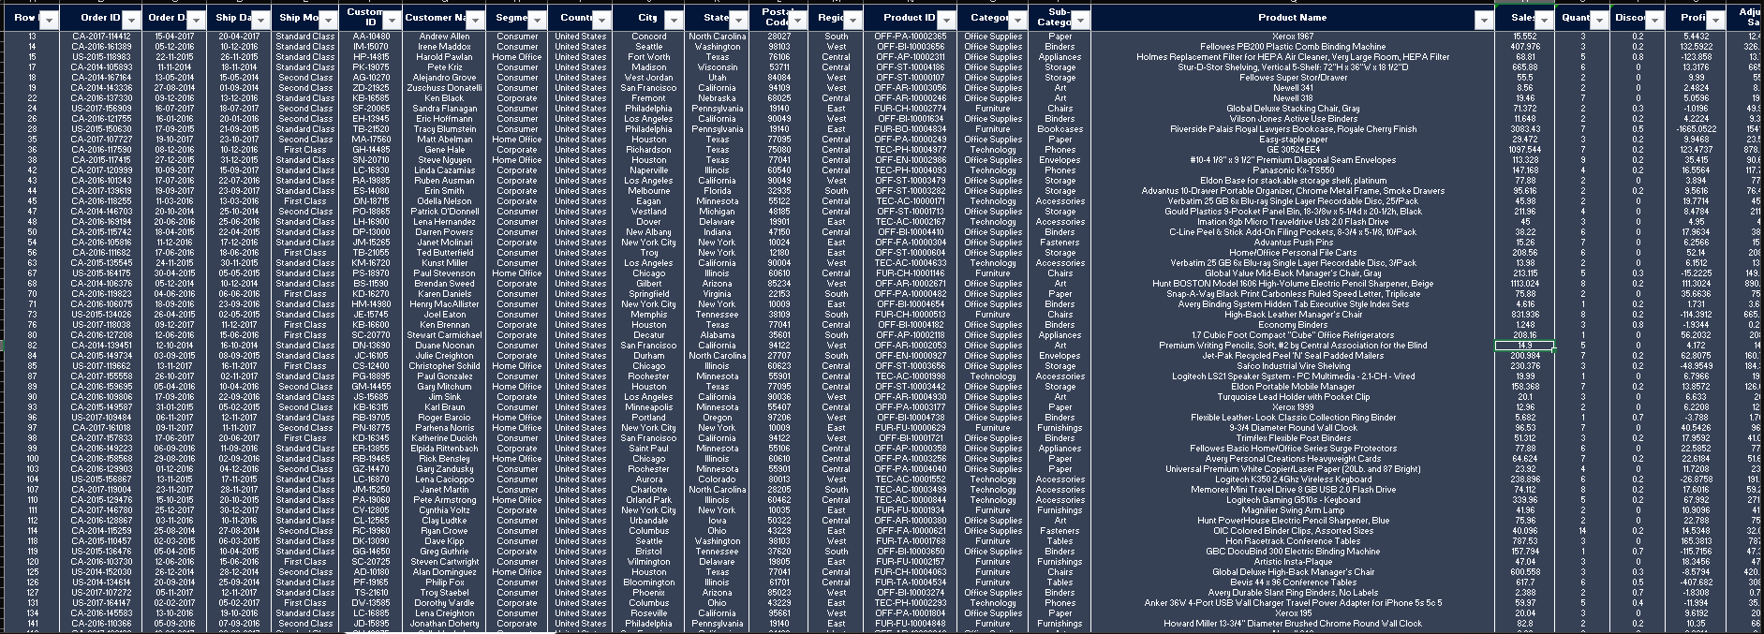
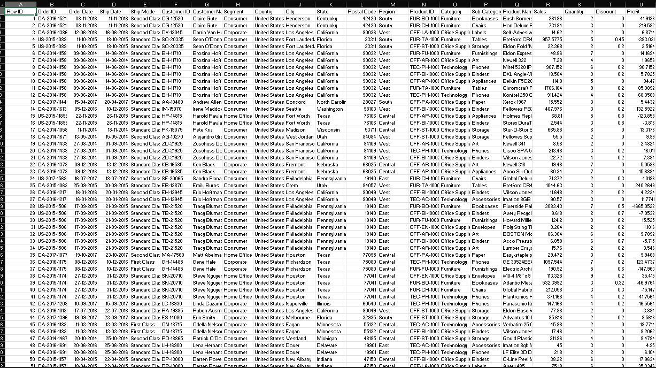

Data Description and Preparation
Dataset Overview: 9,994 rows, 21 columns (Order ID, Product Name, Sales, etc.)
Data Cleaning:
• Removed duplicates (none found)
• Formatted dates, applied currency formatting
• Validated Sales (≥0), Discounts (0-1)
Raw Data
Clean Data

Slide 4
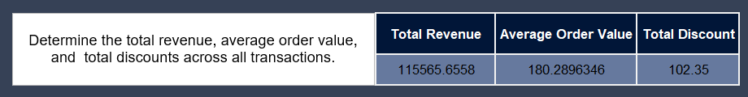
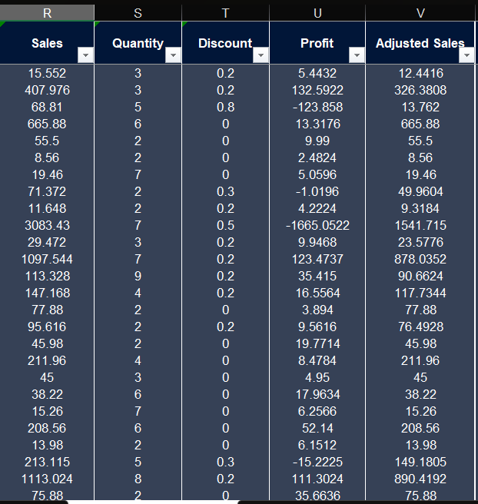
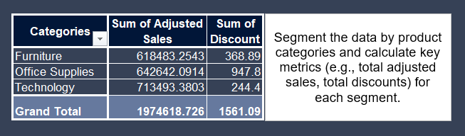

Key Metrics Calculation and Data Analysis
Important Calculations:
Total sales (Gross, Net, Adjusted)
Average sales per order
Discount rates, return rates
Sales by channel/product type
Adjusted Sales: Sales-(sales*Discount)

Slide 5
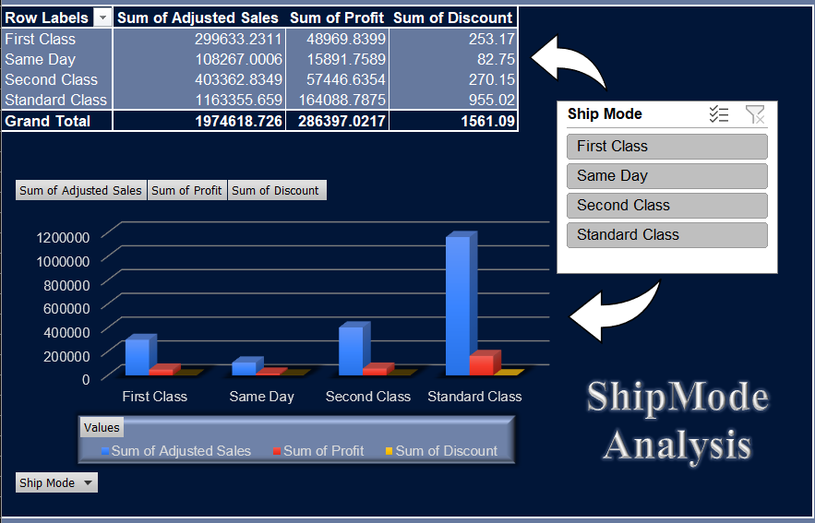
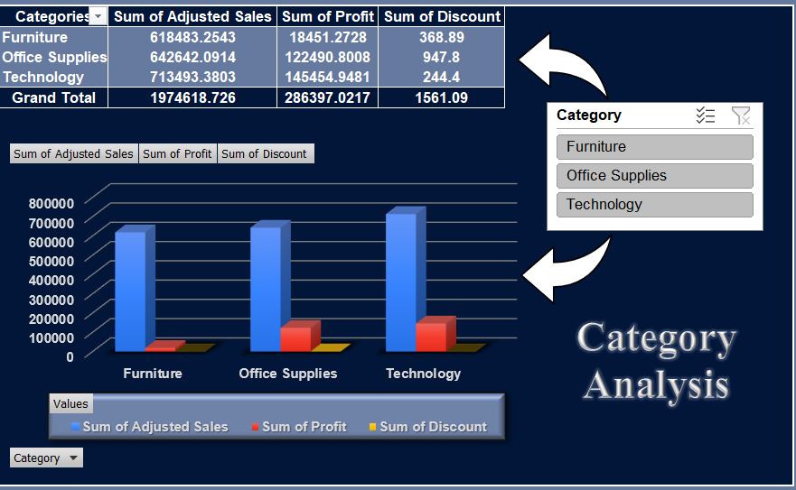
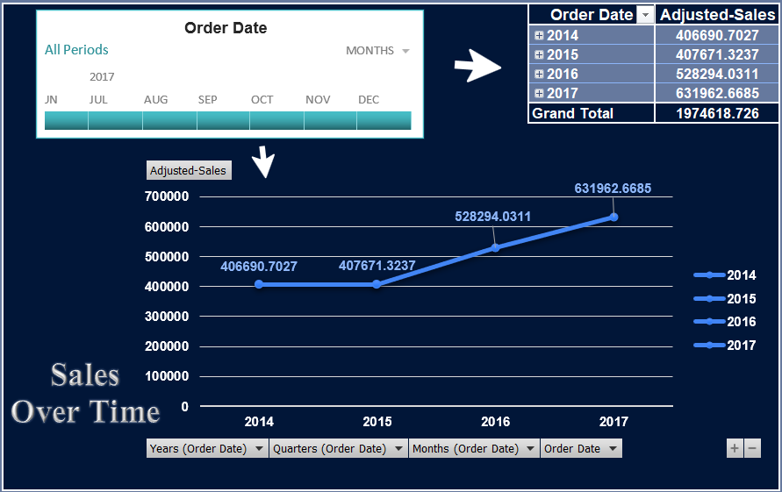
Pivot Tables and Pivot Charts
Pivot Tables: Aggregated by Category, Ship Mode, and Order Date
Metrics: Sum of Adjusted Sales, Total Discounts
Pivot Charts:
• Bar chart : Sales by Category
• Line chart : Sales trends over time

Slide 6
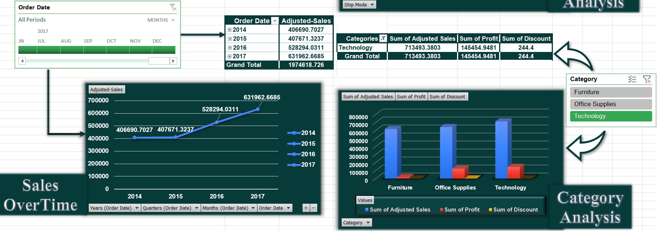

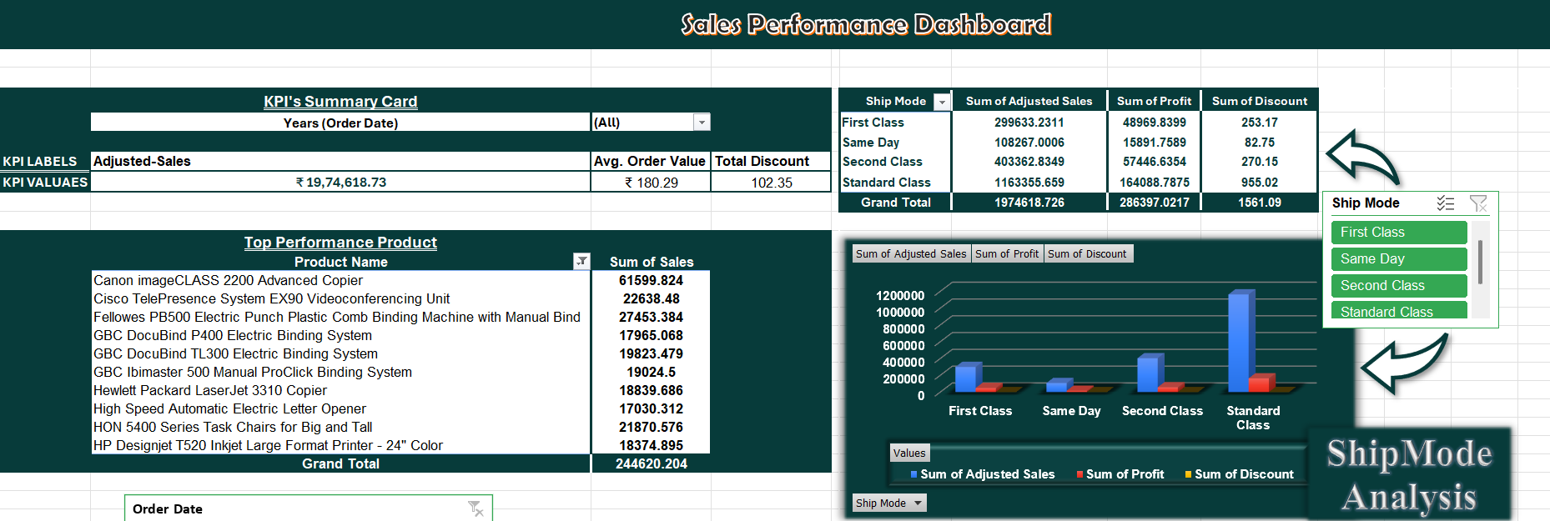
Dashboard Overview
Dashboard Purpose: Interactive view of KPIs and trends Key Performance Indicators: • Total Adjusted Sales
• Average Order Value
• Total Discounts
Top Products
Trends:
Pivot Tables & Pivot Charts of Categories, Ship Mode, Sales Over Time
Slicers for Category, Ship Mode, Date range selector.

Slide 7
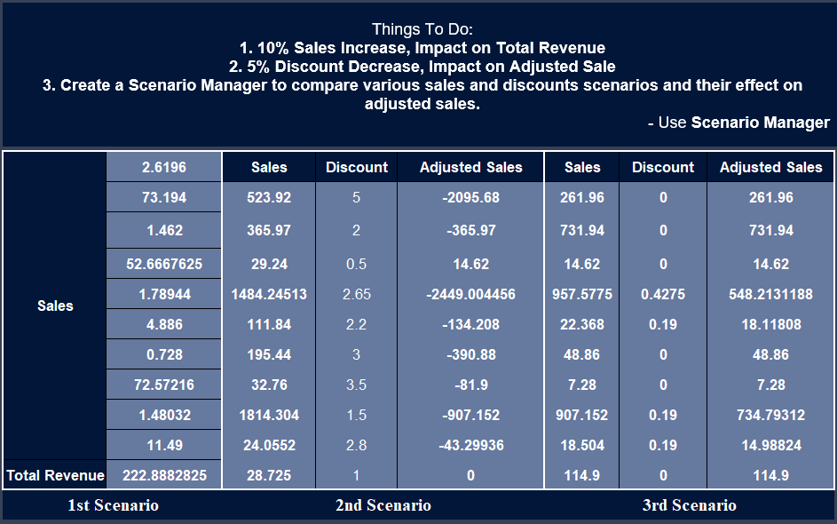
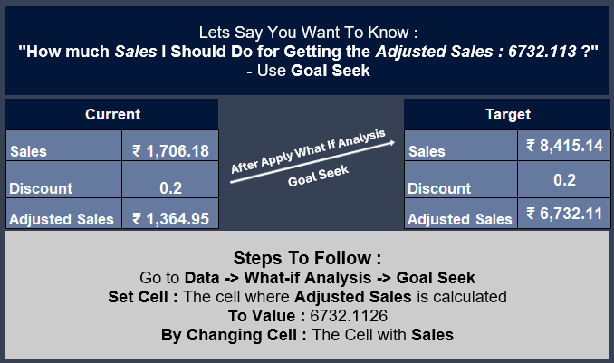
What-If Analysis & Goal Seek
What-If Scenarios:
• 10% Sales increase: Impact on Adjusted Sales
• 5% Discount decrease: Effect on profitability
• Comparing Various Sales & Quantity : Impact on Adjusted Sales
Goal Seek:
• Target: ₹ 6,732.11 profit
• Adjusted: Sales sold.

Slide 8

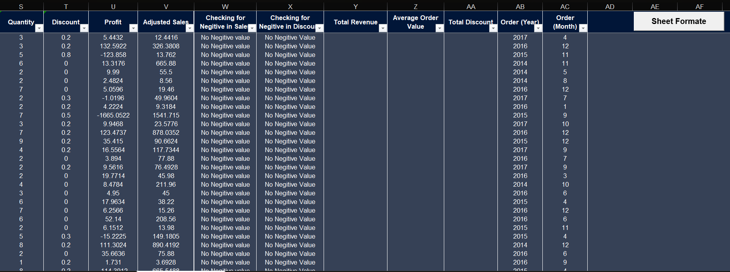
Macros and Automation
Macros Used:
Format Sheet: Applies formatting (bold headers, currency, freeze panes)
Benefits: Saves time, ensures consistency

Slide 9
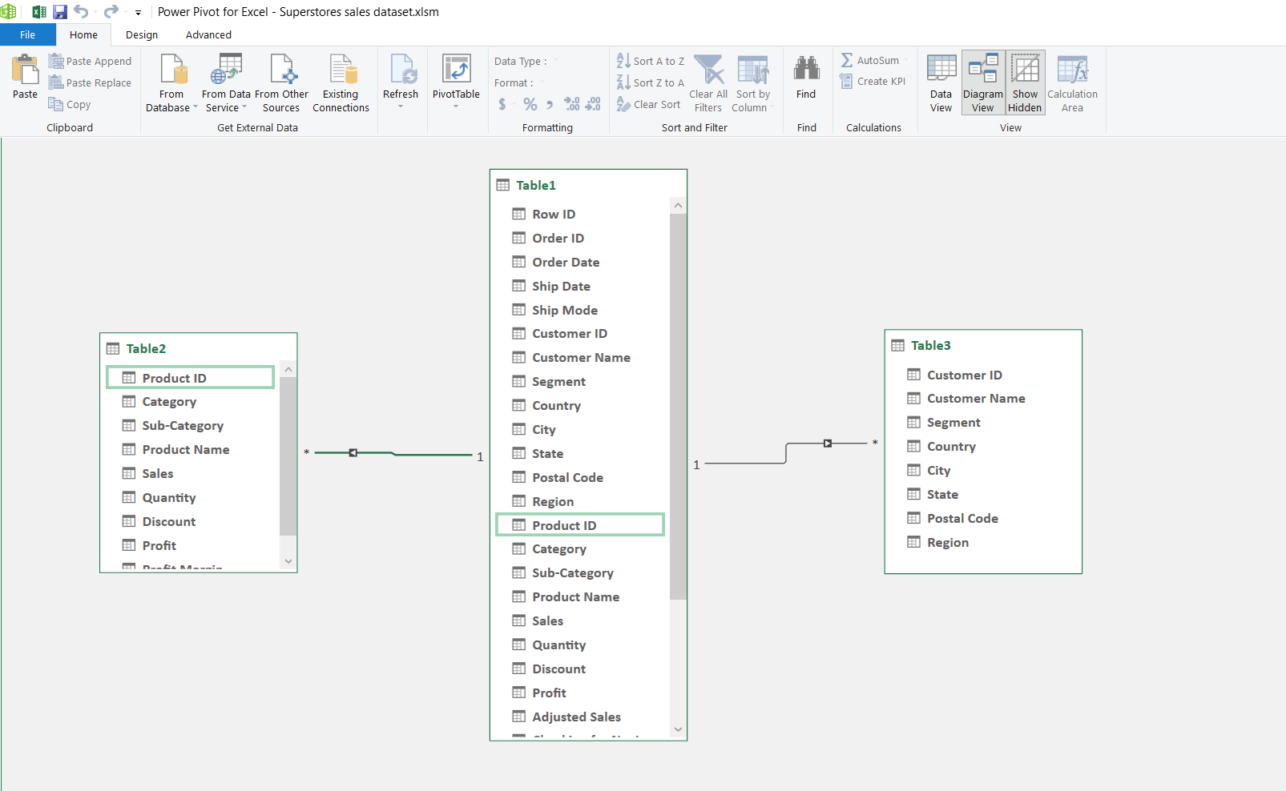
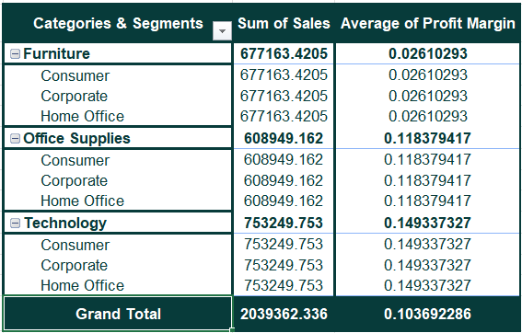
Power Pivot & Data Modeling
Relationship Generated
Generated two tables Product table & Customer Table
Generated relationship b/w 2 new generated table and main data set table
Analysis the sales trends and generated a pivot table from power pivot

Slide 10
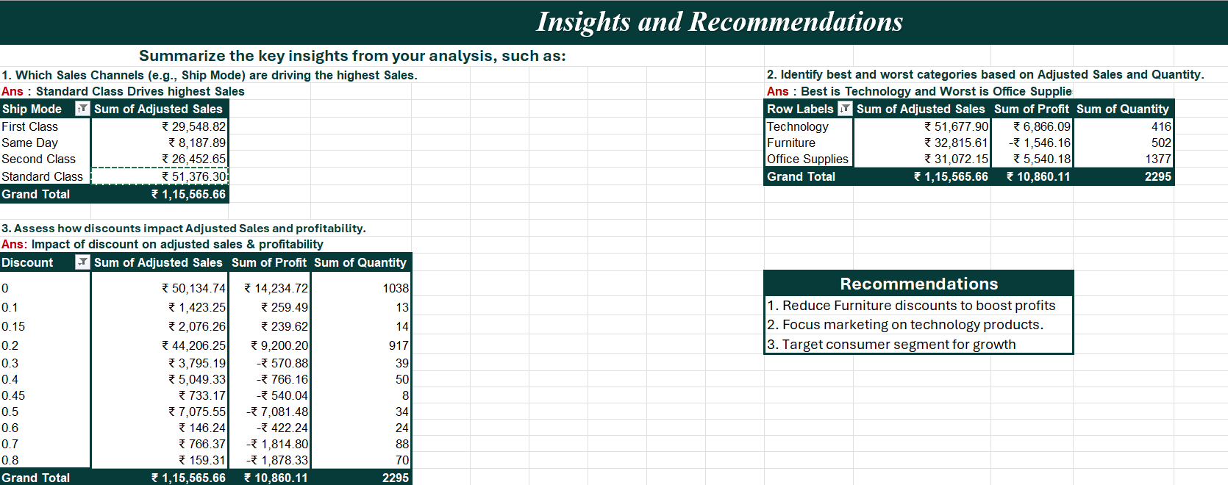
Insights and Recommendations
Key Insights:
• Technology leads in Adjusted Sales (₹ 51,677.90)
• High discounts (> 0.5) cause losses
• Standard Class Sales Peaked (₹ 51,376.30 )
Recommendations:
• Reduce Furniture discounts to boost profits
• Focus marketing on Technology products
• Target Consumer segment for growth

Slide 11
Conclusion
Summary : Optimized Superstore dataset analysis with Excel tools.
Actionable Insights : Impact of Discount, Sales Overtime.
Next Steps :
Forecast sales for the next quarter.
Improve Data Accuracy.

Slide 12
Open for Questions

